Slide 1
Research Report
11/3/2023
Yu Li

Slide 2
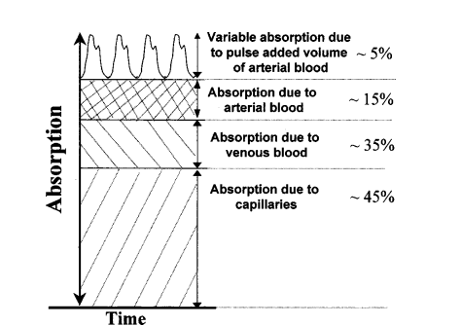
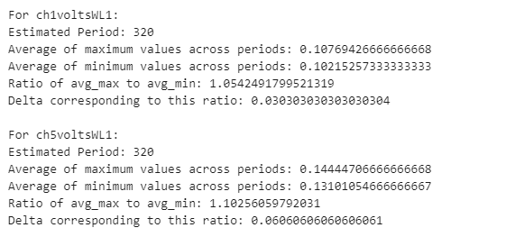
The change in μa in each cycle
The lower layers are static, and the upper layers are about the dynamic changes in the pulsation.
The degree of variation in μa we get from real data is reasonable(Calculation corrected, replacing total photon count with actual photon count).
Reference:
"Trans-abdominal monitoring of fetal arterial blood oxygenation using pulse oximetry," Journal of Biomedical Optics 5(4), (1 October 2000). https://doi.org/10.1117/1.1289359.

Slide 3
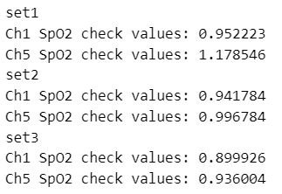


Larger SD area check
S
$$D_{}$$
By increasing the SD area, I got some sets of L-ppath data.
When considering one-subject model, I select 2-3 groups of L-ppath data with close SD area for double check, and the results did not change significantly (change of μa and SpO2).
Maternal tissues
$$l$$
(1)
fetal tissues
(2)
SpO2 ground truth:
Sheep1: 100%
Sheep2: 97%
Sheep3: 94%
Spo2 check values:

Slide 4
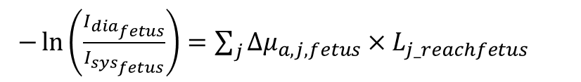

Two-subject model data
S
$$D_{}$$
Step1:Short SD to get the fix Δμa.
Step2:Long SD to focus on fetus.
The work of short SD is similar to one subject, so I recorded the parameters of change of μa under short SD for further work.
Regarding the long SD model, I have obtained the corresponding Lppath data by changing the SD.
Next, I will give mom’s μa a fixed value based on the short SD’s Δμa data, then get the fetal value and do the same check as the previous steps.
Maternal tissues
$$l$$
(1)
fetal tissues
(2)
$−\ln\left(\frac{I_{dia_{fetus}}}{I_{sys_{fetus}}}\right)=\sum_{j}{{Δμ}_{a,j, fetus}×L_{j_reachfetus}}$

